Slide 1
The expressive power of pooling in Graph Neural
Networks
Birva Oza ( 202311050 ) Parshwa Dand ( 202311016 )
Harsh Vyas ( 202311015 ) Ayushi Mehta ( 202311008 )

Slide 2
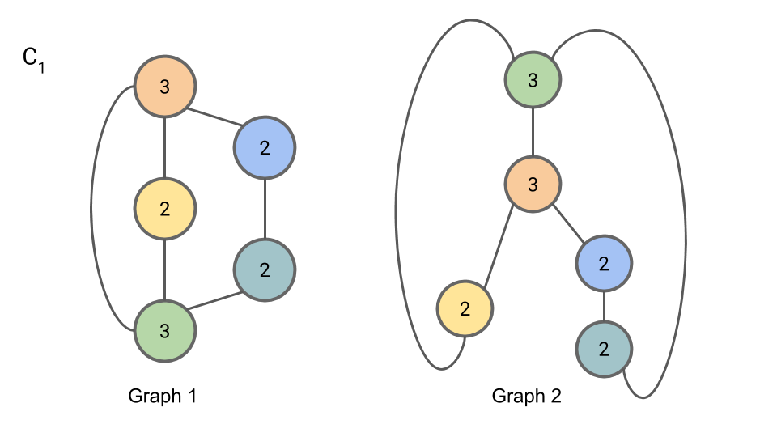
Introduction
Characterizing the expressive power of Graph Neural Networks (GNNs) in terms of their capabilities for testing graph isomorphism.
GNNs with appropriately formulated message-passing (MP) layers areas effective as the Weisfeiler-Lehman isomorphism test (WL test) in distinguish graphs.
By interleaving MP with pooling layers that gradually distill global graph properties through the computation of local summaries, it is possible to build deep GNNs that improve the accuracy in graph classification and node classification tasks.

Slide 3



Graph Neural Network (GNN)

Slide 4
How can we check Expressiveness????
The most common approach is to simply measure the performance of a GNN with pooling layers on a downstream task, such as graph classification.
However, such an approach is highly empirical and provides an indirect evaluation affected by external factors like MP layers ,activation functions, normalization or dropout layers, and optimization algorithms.
The spectral similarity between the original and the coarsened graph topology and ii) its capability of reconstructing the features of the original graph from the coarsened one.

Slide 5
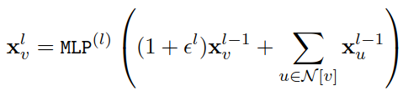
Expressive Power of GNN
An exact test for graph isomorphism has a combinatorial complexity, the WL test for graph isomorphism is a computationally efficient yet effective test that can distinguish a broad range of graphs.
There is a strong analogy between an iteration of the WL-test and the aggregation scheme implemented by MP in GNNs.
The Graph Isomorphism Network (GIN) implements such an injective multiset function as:

Slide 6
Expressive Power of GNN
Under the condition that the nodes’ features are from a countable multiset, the representational power of GIN equals that of the WL test.
Some GNNs can surpass the discriminative power of the WL test by using higher-order generalizations of MP operation.
The WL test for graph isomorphism is a computationally efficient yet effective test that can distinguish a broad range of graphs. The algorithm assigns to each graph vertex a color that depends on the multiset of labels of its neighbors and on its own color. At each iteration, the colors of the vertices are updated until convergence is reached.

Slide 7


Graph Pooling Operators
To formally describe the POOL function, we adopt the Select-Reduce-Connect (SRC) framework, that expresses a graph pooling operator through the combination of three functions: selection, reduction, and connection.
The selection function (SEL) clusters the nodes of the input graph into subsets called supernodes.
with
Typically, a node can be assigned to zero, one, or several supernodes, each with different scores.

Slide 8

Graph Pooling Operators
The reduction function (RED) creates the pooled vertex features by aggregating the features of the vertices assigned to the same supernode.
Finally, the connect function (CON) generates the edges, and potentially the edge features, by connecting the supernodes.

Slide 9
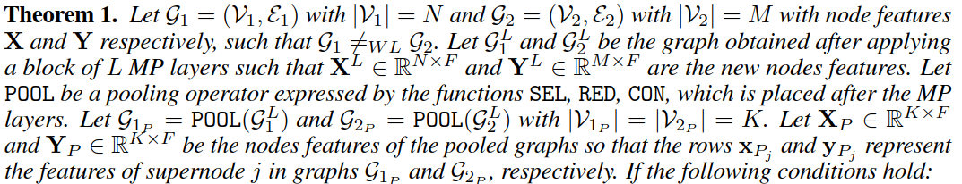
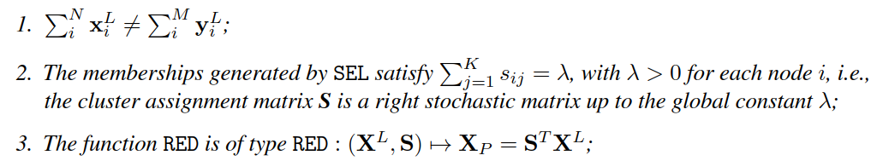
Expressiveness of Pooling Operators

Slide 10
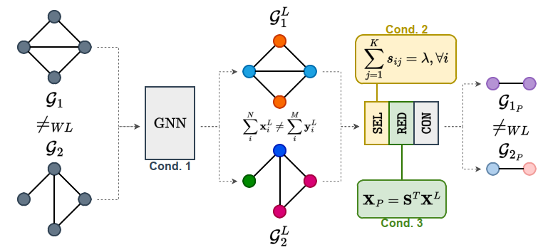
Expressiveness of Pooling Operators

Slide 11



Expressiveness of Pooling Operators
Condition 1 :- Under the assumption that the node features originate from a countable universe, it has been formally proven that there exists a function that, when applied to the node features, makes the sum over a multiset of node features injective. The universal approximation theorem guarantees that such a function. Due to the injectiveness of the coloring function of the WL algorithm, two graphs with different multisets of node features will be classified as non-isomorphic by the WL test and, therefore, can be implemented by an MLP.
Condition 2 :- It implies that all nodes in the original graph must contribute to the supernodes. Moreover, letting the sum of the memberships sij to be a constant λ (usually, λ = 1), places a restriction on the formation of the super-nodes.
Condition 3 :- It requires that the features of the supernodes are a convex combination of the node features . It is important to note that the conditions for the expressiveness only involve SELand RED, but not the CON function.

Slide 12
Dense Pooling Operators
The density of a pooling operator is defined as the expected value of the ratio between the cardinality of a supernode and the number of nodes in the graph. A method is referred to as dense if the supernodes have cardinality O(N).
Pooling methods can also be distinguished according to the number of nodes K of the pooled graph. If K is constant and independent of the input graph size, the pooling method is fixed. On the other hand, if the number of supernodes is a function of the input graph, the method is adaptive.
The method is said to be trainable, meaning that the operator has parameters that are learned by optimizing a task-driven loss function. Otherwise, the methods are non-trainable.

Slide 13


Dense Pooling Operators
The methods in this class of pooling operators are DiffPool, MinCutPool, and DMoN.
Besides being dense, all these operators are also trainable and fixed.
DiffPool, MinCutPool, and DMoN compute a cluster assignment matrix either with an MLP or an MP-layer, which is fed with the node features and ends with a softmax.
The main difference among these methods is in how they define unsupervised auxiliary loss functions, which are used to inject a bias in how the clusters are formed. Thanks to the softmax normalization, the cluster assignments sum up to one, ensuring condition 2.
The pooled node features are computed as , making also condition 3 satisfied.
Therefore, we can say that all dense methods preserve the expressive power of the preceding MP layers.

Slide 14
Non-Expressive Sparse Pooling Operators
A pooling operator is considered sparse if the supernodes generated have constant cardinality O(1).
Members of this category are Top-k, AS-APool, SAGPool and PanPool, which are also trainable and adaptive.
These methods reduce the graph by selecting a subset of its nodes based on a ranking score and they mainly differ in how their SEL function computes such a score.
Top-k :- This method ranks nodes based on a score obtained by multiplying the node features with a trainable projection vector. A node i is kept (si = 1) if is among the top-K in the ranking and is discarded (si = 0) otherwise.
SAGPool :- It simply replaces the projection vector with an MP layer to account for the graph’s structure when scoring the nodes.

Slide 15
Non-Expressive Sparse Pooling Operators
ASAPool :- It examines all potential local clusters in the input graph given a fixed receptive field and it employs an attention mechanism to compute the cluster membership of the nodes. The clusters are subsequently scored using a particular MP operator.
PanPool :- The scores are obtained from the diagonal entries of the maximal entropy transition matrix, which is a generalization of the graph Laplacian.
Regardless of how the score is computed, all these methods generate a cluster assignment matrix S where not all the rows sum to a constant. Indeed, if a node is not selected, it is not assigned to any supernode in the coarsened graph. Therefore, these methods fail to meet condition 2.
The RED function of all these methods the features of each selected node are multiplied by its ranking score, making condition 3 also unsatisfied.

Slide 16
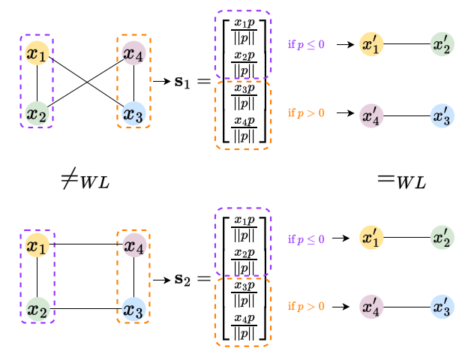
Non-Expressive Sparse Pooling Operators

Slide 17

Expressive Sparse Pooling Operator
They assign each node in the original graph to exactly one supernode and, thus, satisfy condition 2.
In matrix form and letting λ = 1, the cluster assignment would be represented by a sparse matrix S that satisfies and where every row has one entry equal to one and the others equal to zero.
Some sparse pooling operators includes Graclus, ECPool, and k-MISPool.
Graclus :- It is a non-trainable, greedy bottom-up spectral clustering algorithm, which matches each vertex with the neighbor that is closest according to the graph connectivity. When Graclus is used to perform graph pooling, the RED function is usually implemented as a max_pool operation between the vertices assigned to the same cluster.

Slide 18

Expressive Sparse Pooling Operator
ECPool :-
Then, iterates over each edge, starting from those with higher scores, and contracts it if neither nodes i and j are attached to an already contracted edge.
The endpoints of a contracted edge are merged into a new supernode , while the remaining nodes become supernodes themselves. Since each supernode either contains the nodes of a contracted edge or is a node from the original graph, all columns of S have either one or two entries equal to one, while each row sums up to one.
ECPool met the expressiveness conditions.

Slide 19

Expressive Sparse Pooling Operator
k-MISPool :- It identifies the supernodes with the centroids of the maximal k-independent sets of a graph. To speed up computation, the centroids are selected with a greedy approach based on a ranking vector π.
Since π can be obtained from a trainable projector p applied to the vertex features, , k-MISPool is a trainable pooling operator.
k-MISPool assigns each vertex to one of the centroids and aggregates the features of the vertex assigned to the same centroid with a sum_pool operation to create the features of the supernodes.
Therefore, k-MISPool satisfies the expressiveness conditions.

Slide 20
EXPWL-1 Dataset
A recent dataset called EXP was created for this purpose, but it's beyond the scope of our study. Hence, They've developed a modified version named EXPWL1. It includes graphs representing propositional formulas, each consisting of pairs (Gi, Hi) that are distinguishable by the WL test, encoding formulas with opposite SAT outcomes. Any GNN with the same expressive power as the WL test should be able to distinguish them with close to 100% accuracy. They've expanded the dataset to 3000 graphs, with each graph now averaging 55 to 76 nodes, to allow for aggressive pooling without simplifying the graph structure excessively.

Slide 21
Steps per epoch ( Paper Results vs Our Results )
Pooling | s/epoch(In paper) | s/epoch(Our observation)
No-pool | 0.33s | 1.98s
DiffPool | 0.69s | 2.00s
DMoN | 0.75s | 2.28s
MinCut | 0.72s | 1.90s
ECPool | 20.71s | 14.78s
Graclus | 1.00s | 1.92s
k-MIS | 1.17s | 2.4s
Top-k | 0.47s | 1.55s
Pooling | s/epoch(In paper) | s/epoch(Our observation)
Top-k | 0.47s | 1.55s
PanPool | 3.82s | 5.03s
ASAPool | 1.11s | 3.37s
SAGPool | 0.59s | 1.55s
Rand-dense | 0.41s | 1.67s
Cmp-Graclus | 8.08s | 10.00s

Slide 22
Classification Results ( Paper vs Our Results )
Pooling | Test Acc(In paper) | Test Acc(Our observation) | Expressive
No-pool | 99.3 | 99.7 | ✅
DiffPool | 97.0 | 98.3 | ✅
DMoN | 99.0 | 98.6 | ✅
MinCut | 98.8 | 99.6 | ✅
ECPool | 100.0 | 100.0 | ✅
Graclus | 99.9 | 99.7 | ✅
Pooling | Test Acc(In paper) | Test Acc(Our observation) | Expressive
k-MIS | 99.9 | 100.0 | ✅
Top-k | 67.9 | 49.6 | ❌
PanPool | 63.2 | 57.6 | ❌
ASAPool | 83.5 | 84.3 | ❌
SAGPool | 79.5 | 65.3 | ❌
Rand-dense | 91.7 | 93.0 | ✅
Cmp-Graclus | 91.9 | 89.6 | ✅

Slide 23
Graph Convolutional Network (GCN)
Consider a graph G=(V,E) with N nodes and F initial features for each node. Node features are represented as X with dimension N×F.
Convolutional Operation:
H^{(l+1)} = 𝝈(D^{-1/2} * A * D^{-1/2} * H^{(l)} * W^{(l)})
A = adjacency matrix + identity, D = diagonal degree matrix, W^{(l)} = weight matrix, 𝝈= activation function,H^{(l)} = the node features.
Aggregation :
The convolved features are aggregated and transformed using a weight matrix W to obtain the updated node representations.

Slide 24
Graph Convolutional Network (GCN)
Readout Operation:
After multiple convolutional layers, a readout operation is performed to obtain a graph-level representation.
The readout function aggregates node features across the entire graph to produce a fixed-size representation.

Slide 25
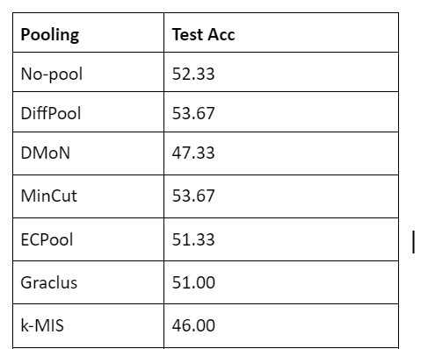

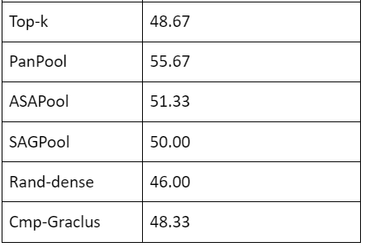
Results

Slide 26
Analysis
Using Graph Convolutional Networks (GCNs) for isomorphic testing could be an interesting approach, but it may face some challenges due to the nature of isomorphism and the capabilities of GCNs
GCNs are powerful tools for learning representations of graph-structured data and performing tasks such as node classification, link prediction, and graph classification. However, directly applying GCNs to isomorphism testing might not be straightforward due to the following reasons:
Permutation Invariance.
Complexity
Limited Expressiveness

Slide 27
Contribution
Parshwa and Ayushi collaborated closely throughout the project, jointly accomplishing various tasks. They worked together to import the EXPWL1 dataset and conducted preprocessing tasks necessary to make the dataset ready for experimentation. Additionally, they co-led the implementation and optimization of graph isomorphism tests. They explored and implemented several pooling operators, including DiffPool, panpool, graclus, ASAPool, and dense random pooling. They worked collaboratively to fine-tune the parameters of these pooling operators, aiming to optimize their effectiveness in preserving graph isomorphism while ensuring computational efficiency.
Birva and Harsh collectively experimented with MinCutPool, Top-k Pool, SAGPool, EdgePool, and DMON Pooling operators, aiming to provide a comprehensive assessment of different pooling methodologies. They fine-tuning hyperparameters, recognizing the critical role they play in optimizing the performance of Graph Neural Networks (GNNs) with different pooling operators. By meticulously adjusting parameters such as learning rates, epochs, and batch sizes, they sought to achieve superior results while ensuring the reproducibility of experimental findings. They meticulously documented the experimental procedures, code implementations, and parameter configurations.
On challenging tasks like implementing Comp Graclus and k-MIS pooling, as well as incorporating Graph Convolutional Networks (GCNs), the team demonstrated effective teamwork and shared responsibility. Each member contributed to the implementation effort, ensuring accuracy and completeness in documenting the research process. Throughout the implementation process, team members provided support and assistance to one another, fostering a collaborative environment. Notably, each team member possessed a comprehensive understanding of every aspect of the research, including the intricacies of GCN implementation and its integration into the project's framework.

